Slide 1
Market trends and navigating uncertainty
Angela Riley, Head of Sales

Slide 2
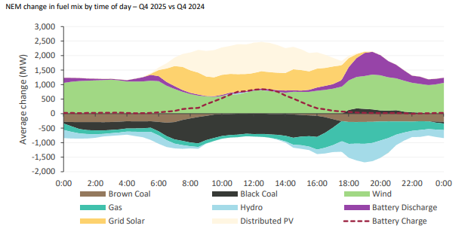
Renewables and BESS – displacing higher cost generation
Source: AEMO

Slide 3
Market trends – impact on large energy users
  Supply shifts
  New products and procurement approaches are available
  Delays to new generation
  CIS doesn’t guarantee construction
  Demand for PPAs growing
  Evolving reforms
  GHG Protocol, Nelson Review,
  transition to REGOs.
  Prepare now

Slide 4

Key takeaways
Uncertainty is here to stay
Suppliers and their solutions are evolving to meet market needs - backed by technology and data
Trusted partners provide insights to help manage through complexity and build resilience

